Slide 1
ns-3 Training: Packets

Slide 2
ns-3 Packet
Packet is an advanced data structure with the following capabilities
Supports fragmentation and reassembly
Supports real or virtual application data
Extensible
Serializable (for emulation)
Supports pretty-printing
Efficient (copy-on-write semantics)

Slide 3
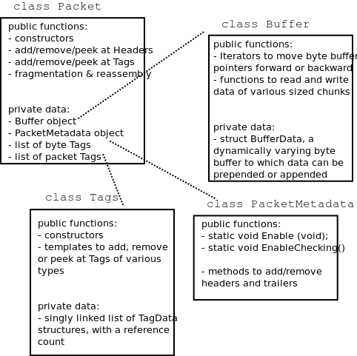
ns-3 Packet structure
Analogous to an mbuf/skbuff

Slide 4
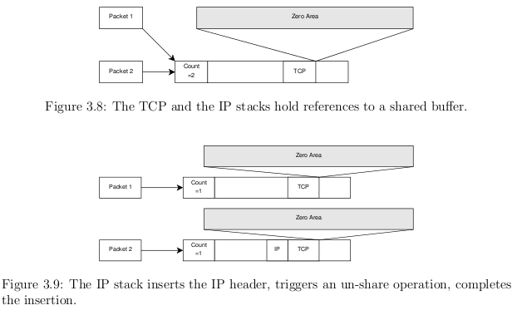
Copy-on-write
Copy data bytes only as needed
Figure source: Mathieu Lacage's Ph.D. thesis

Slide 5
Headers and trailers
Most operations on packet involve adding and removing an ns3::Header
class ns3::Header must implement four methods:
Serialize()
Deserialize()
GetSerializedSize()
Print()

Slide 6
Headers and trailers (cont.)
Headers are serialized into the packet byte buffer with Packet::AddHeader() and removed with Packet::RemoveHeader()
Headers can also be 'Peeked' without removal
Ptr<Packet> pkt = Create<Packet> ();
UdpHeader hdr; // Note: not heap allocated
pkt->AddHeader (hdr);
Ipv4Header iphdr;
pkt->AddHeader (iphdr);

Slide 7
Packet tags
Packet tag objects allow packets to carry around simulator-specific metadata
Such as a "unique ID" for packets or
Tags may associate with byte ranges of data, or with the whole packet
Distinction is important when packets are fragmented and reassembled
Tags presently are not preserved across serialization boundaries (e.g. MPI)

Slide 8
PacketTag vs. ByteTag
Two tag types are available: PacketTag and ByteTag
ByteTags run with bytes
PacketTags run with packets
When Packet is fragmented, both copies of Packet get copies of PacketTags
When two Packets are merged, only the PacketTags of the first are preserved
PacketTags may be removed individually; ByteTags may be removed all at once

Slide 9
Tag example
Here is a simple example illustrating the use of tags from the code in src/internet/model/udp-socket-impl.cc:
Ptr<Packet> p; // pointer to a pre-existing packet
SocketIpTtlTag tag
tag.SetTtl (m_ipMulticastTtl); // Convey the TTL from UDP layer to IP layer
p->AddPacketTag (tag);
This tag is read at the IP layer, then stripped (src/internet/model/ipv4-l3-protocol.cc):
uint8_t ttl = m_defaultTtl;
SocketIpTtlTag tag;
bool found = packet->RemovePacketTag (tag);
if (found)
{
ttl = tag.GetTtl ();
}

Slide 10
Packet metadata
Packets may optionally carry metadata
record every operation on a packet's buffer
implementation of Packet::Print for pretty-printing of the packet
sanity check that when a Header is removed, the Header was actually present to begin with
Not enabled by default, for performance reasons
To enable, insert one or both statements:
Packet::EnablePrinting ();
Packet::EnableChecking ();

Slide 11
Ptr<Packet>
Packets are reference counted objects that support the smart pointer class Ptr
Use a templated "Create" method instead of CreateObject for ns3::Objects
Typical creation:
Ptr<Packet> pkt = Create<Packet> ();
In model code, Packet pointers may be const or non-const; often Packet::Copy() is used to obtain non-const from const
Ptr<const Packet> cpkt = ...;
Ptr<Packet> p = cpkt->Copy ();

